Slide 1
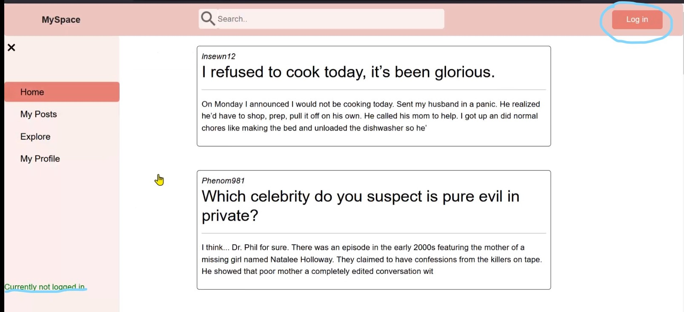
MySpace Welcome to the Demo
Website that allows users to view posts , stories and make comments on posts as well create their own posts and stories by registering and then logging in. Unregistered users can view others posts and stories but are not able to make their own unless they register.
We have also included features like active search bar and a collapsible navigation bar in order to make the website easy to use.

Slide 2
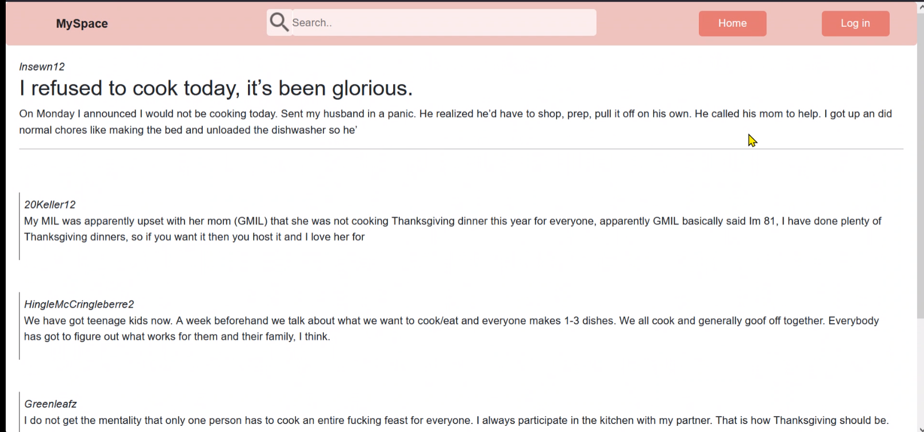
You can click on the discussion posts to expand them and read the content and comments even when you are logged out

Slide 3

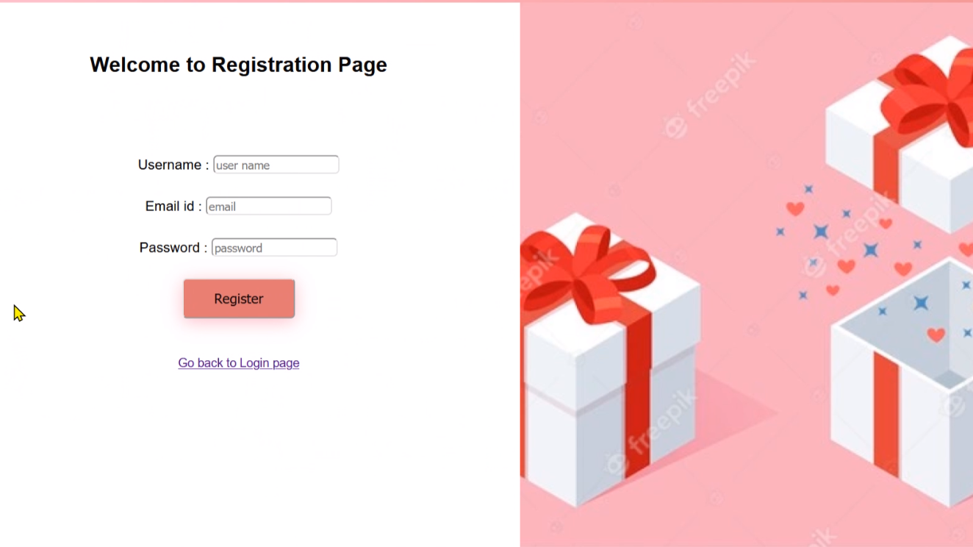
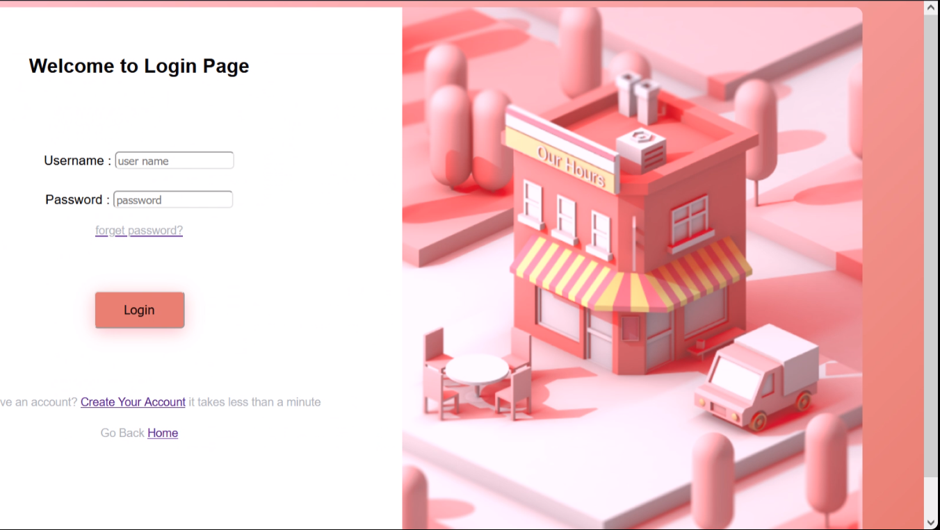
MySpace The Login Page And Registration Page
You can create account with our website. All the data is stored by using MySQL in a Database. You can Login using the details you used to create the account with.
Once you are logged in you get the additional feature to create a post, comment on other posts and to view your posts separately.
We have made our website layout responsive.

Slide 4
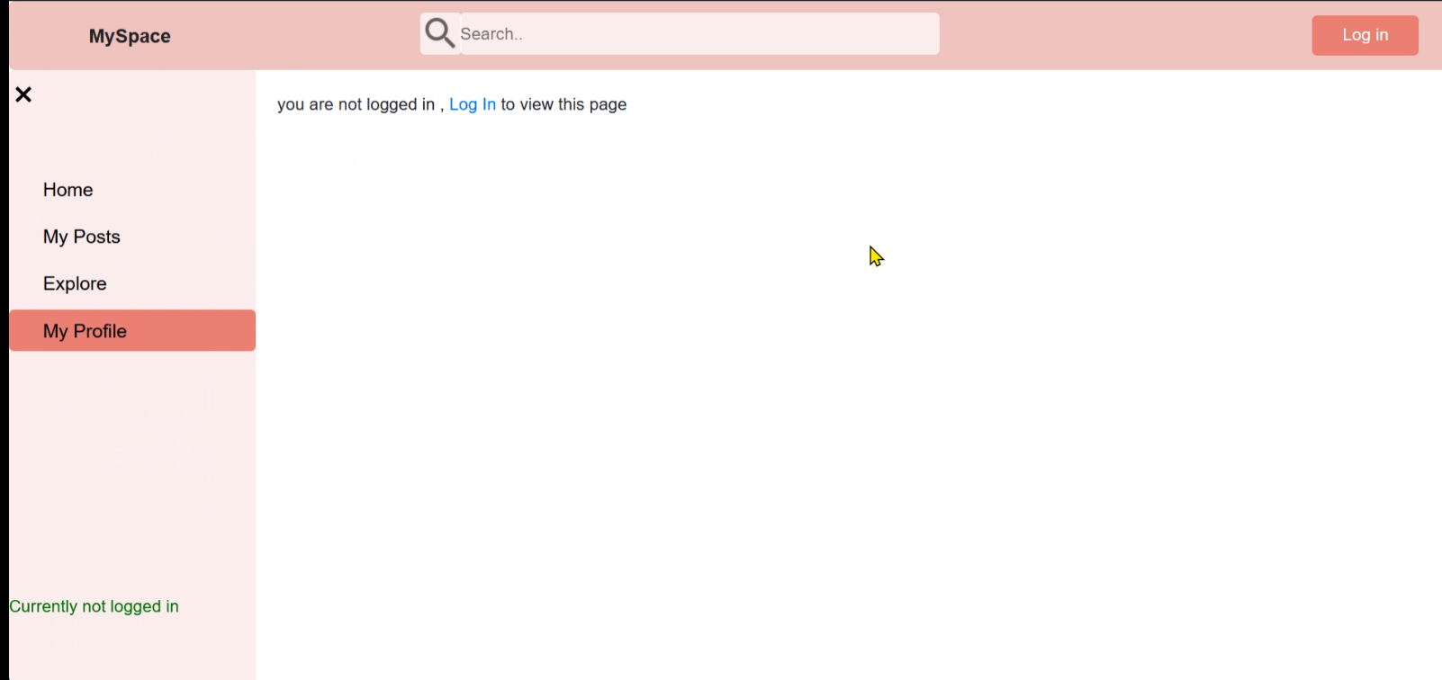
State of the user You can not view My Posts or My profile Section until you are logged in. Once you are logged in , You can see your status in the navigation bar at the bottom in green color and also at the button on the top right corner.

Slide 5
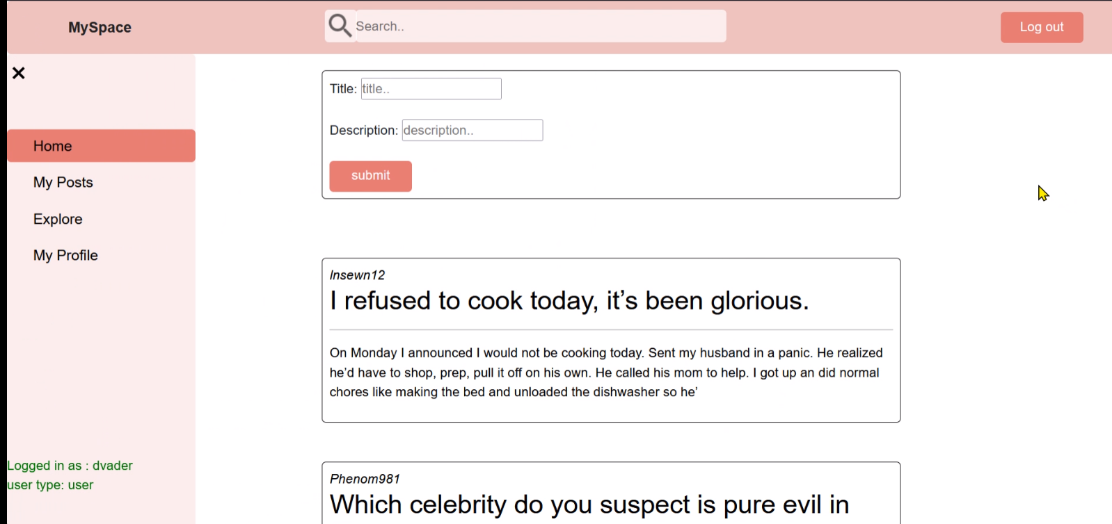
Once you have logged in , You can create posts using the box. In addition to that You can also see your status in the navigation bar. There are two types of logins possible ( user and admin)

Slide 6
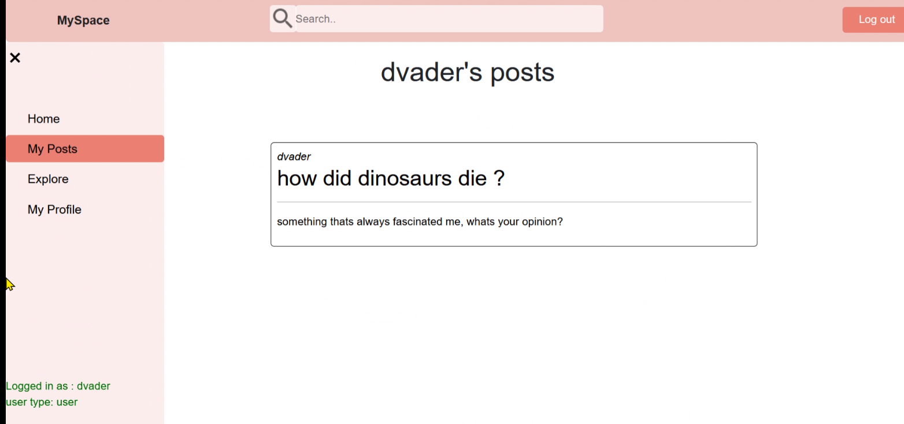
Additionally, you can also view your posts separately under MY posts section which is only available if you have logged in. In order to logout, you just need to click on the button on the top right corner which says “ Log Out“

Slide 7
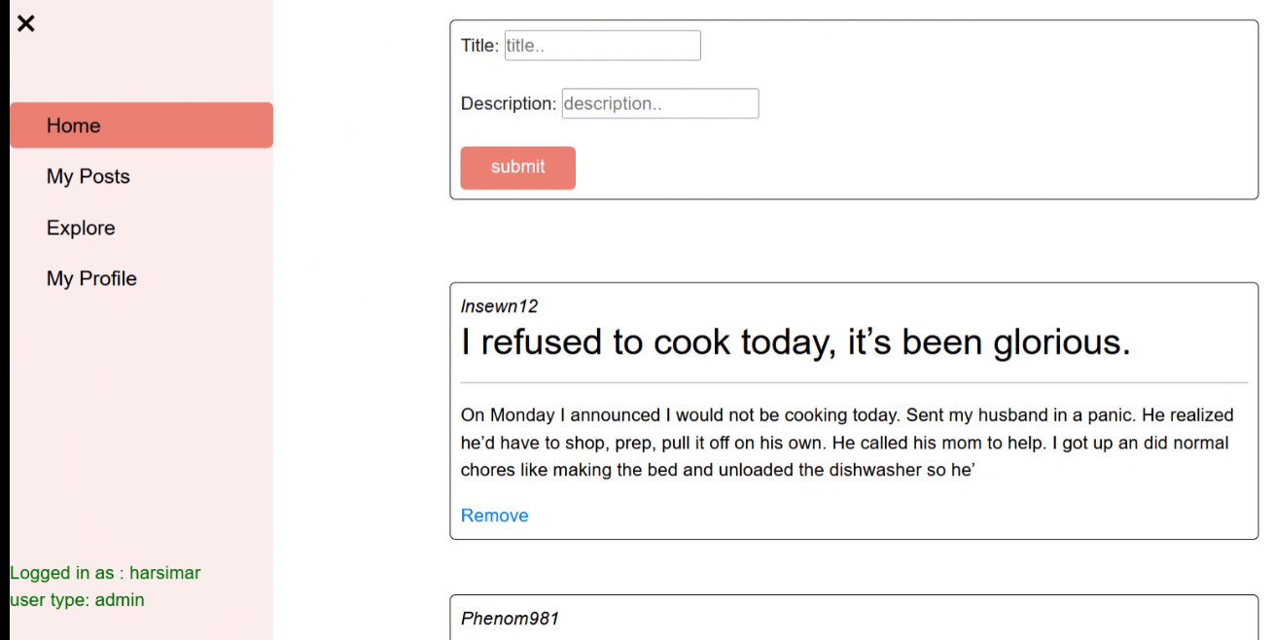
Admin login : When you are logged in as admin , you get an extra feature to remove posts or comments as per your requirements. You can see your status of admin in the navigation bar as well.

Slide 8
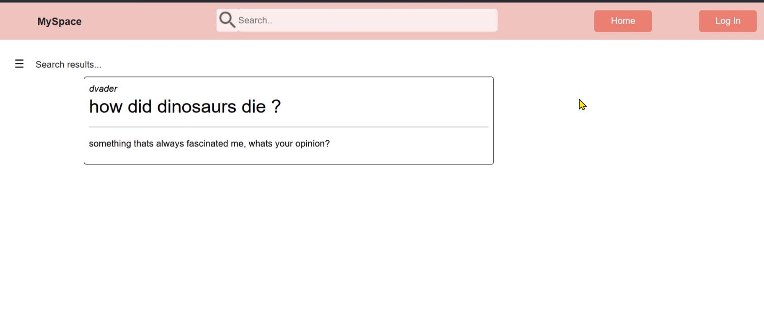
The Search Feature You can use the search bar to search for the discussion posts and comments created by any users based on their usernames. This feature is available even if you are not logged into the website.

Slide 9
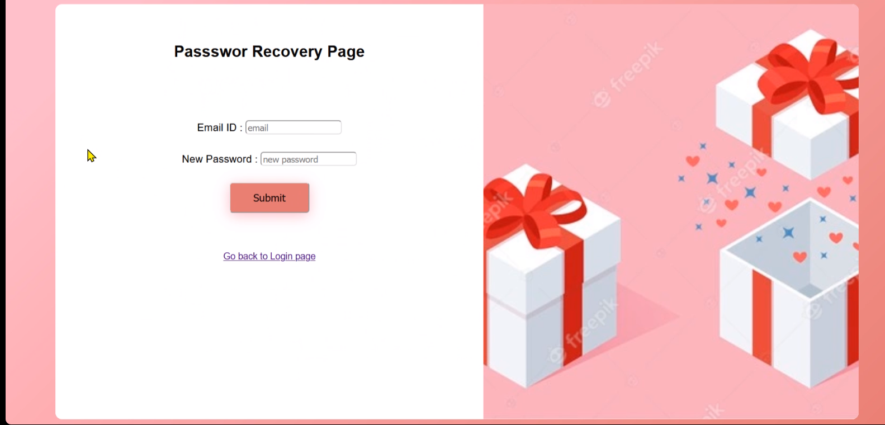
Forgot password Feature In the login page , You can click on the forget password link to create a new password with just the use of your email id.

